Slide 1



Module 3. Lesson 4.
The Smart Notes
App P. 3
Link to the methodological guidelines

Slide 2

Module 3. Lesson 4. The Smart Notes App. P. 3
Discussion:
The optimal solution

Slide 3
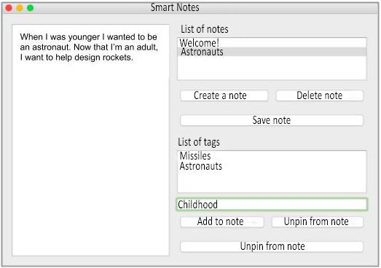


Let’s keep working on the order!
The Scientific Institute of Theoretical Physics placed an order for the creation of a Smart Notes App.
Last time we:
Have completed the Smart Notes project.
Have made the app’s interface fully active.
Have implemented searching by tag.
Discussion of tasks
Cole,
senior software developer
Notes:
Smart Notes
When I was younger I wanted to be an astronaut. Now that I’m an adult, I want to help design rockets.
List of notes
Welcome!
Astronauts
Create a note
Delete note
Save note
List of tags
Missiles
Astronauts
Childhood
Add to note
Unpin from note
Search notes by tag

Slide 4
Storing data for notes
Data for notes is stored in a json file.
After reading the data, the program works with the dictionary of dictionaries.
When I was younger I wanted to be an astronaut. Now that I’m an adult, I want to help design rockets.
Discussion of tasks
Notes:
Smart Notes
When I was younger I wanted to be an astronaut. Now that I’m an adult, I want to help design rockets.
List of notes
Welcome!
Astronauts
Create a note
Delete note
Save note
List of tags
Missiles
Astronauts
Childhood
Add to note
Unpin from note
Search notes by tag

Slide 5

Is this the optimal solution?
The customers have reviewed the preliminary solution.
This letter of response has arrived:
Is this really the most optimal solution?
Sometimes I work on devices that don’t have our app installed. Is it still possible to use these devices for editing the files with notes?
Discussion of tasks

Slide 6
We can work with text files and json files.
Now we can see if we’ve really chosen the optimal solution for everyday work.
Discussion of tasks

Slide 7


To do this, today we’ll need to discuss:
Can it be optimal to store notes in text files?
Is it convenient to work with notes in files? Is it possible to edit them without the app?
Is it better to store notes in one text file or in several?
Discussion of tasks

Slide 8

Module 3. Lesson 4. The Smart Notes App. P. 3
Brainstorming:
Json files or text files?

Slide 9
Is it possible to optimally store notes in text files?
Brainstorming
To answer this question, compare json files and text files

Slide 10
Let’s compare the structures inside different types of files
Text files
Json files
?
?
Brainstorming
How is data presented in different types of files?

Slide 11
Let’s compare the structures inside different types of files
Text files
Json files
Format: any
About the moon / Why is the moon a satellite and not a planet? / #moon #planet
Format: Dictionaries or lists
{
"About the moon" : {
"text": "Why is the moon a satellite and not a planet?"
"tags": [ "moon", "planet" ]}
}
Brainstorming
data.txt
data.json

Slide 12
How to correctly read data from a text file?
Brainstorming
Let’s say that the file has the surnames of all of the students, as well as their grades.
When reading the file, how can we understand where the student’s last name ends and their grade begins?

Slide 13
Reading data from a text file:
Different types should be separated from each other.
Brainstorming
Let’s say that the file has the surnames of all of the students, as well as their grades.
When reading the file, how can we understand where the student’s last name ends and their grade begins?
Surname
Grade
Separator
(for example, a space)

Slide 14
Separating data within a file:
Text files
Json files
The data is separated according to the algorithm written by the user.
The data is separated automatically according to the arrangement of the dictionary.
Brainstorming

Slide 15
Separating data within a file:
Text files
Json files
01.07_Children’s Day\n
04.11_Birthday\n
01.09_Day of Knowledge\n
{ "Ocean" :
{"tags": ["ocean", "sea"], "text": "Can a large sea become an ocean?"}}
Brainstorming
The date is separated from the holiday with an underscore.
The units of data are located on separate lines.

Slide 16
Problem:
The more data you have in a text file, the harder it will be to write a parser
Brainstorming
What if there are newline transitions in the text of the note?
What separator should we choose to make sure the user doesn’t use it in a set of text or tags?

Slide 17
A parser is a program that picks out pieces of information in the data.
You actually used a parser when you were working with text files.
You selected lines in the text (1 line = 1 student)
You split the strings into substrings (surname, name, grade).
Brainstorming
Parsing happens automatically in json files.

Slide 18
Storing notes in text files:
Storing all of the notes in one text file
Storage type
“One note, one file”
Which approach is more convenient?
Brainstorming

Slide 19
Storing notes in text files:
Storing all of the notes in one text file.
Storage type
“One note, one file”
The program only works with one text file.
Notes can be created on a phone/laptop without the Smart Notes App, then simply copied to a file in the project folder.
These notes are easy to send to others and print out.
Brainstorming
Simple for data recording,
but difficult for parsing.
Easy to collaborate with other devices and easy to parse.

Slide 20
Plan for finishing work on Smart Notes:
Let’s see how well we know the basics of working with files
(first half of the workday).
Let’s find a solution, program it, and compare it with the one we already have
(second half of the workday).
Brainstorming

Slide 21

Module 3. Lesson 4. The Smart Notes App. P. 3
Visual Studio Code:
The Smart Notes
App

Slide 22




Qualification Test
Test: Working with Files
Test your knowledge of working with files!
VS Code
Working on the platform

Slide 23
Module 3. Lesson 4. The Smart Notes App. P. 3
Brainstorming:
Smart Notes in Text Files.

Slide 24
Let’s see how the app changes when we switch to text files.
Review of the new topic

Slide 25
Necessary changes:
Data storage
App functionality
Interface
How is data storage organized using the
“one note, one file” method?
First and foremost, what part of the app needs to be changed?
Does anything need to be changed in the interface?
Review of the new topic

Slide 26
Necessary changes:
Data storage
App functionality
Interface
For the starting note, create a file named 0.txt. The rest of the files will be named 1.txt, 2.txt, and so on.
What needs to be changed is the creation of new notes and the storage of notes in a file.
Remains the same.
Review of the new topic
Every data item (name, text, tags) will be written on a new line.
The rest of the functions either work with the ready-made structures or work in a similar way.
1.
2.

Slide 27
1. Data Storage
To change the data storage, create a starting note, and read it.
Note_0
Note_text
Tag_0 Tag_1
How do I read the data?
Review of the new topic
0.txt

Slide 28
1. Data Storage
To change the data storage, create a starting note, and read it.
Create a list of notes to collect data about the note
Note_0
Note_text
Tag_0 Tag_1
Open file 0.txt for reading
Iterate over each line string in the file
Review of the new topic
Read the string “line” from the file
Delete the “/n”
Add a line in a note
0.txt

Slide 29
1. Data Storage
To change the data storage, create a starting note, and read it.
Create a list of notes to collect data about the note
note =
[
Note_0
,
Open file 0.txt for reading
Iterate over each line string in the file
Review of the new topic
Note_text
,
Read the string “line” from the file
Tag_0 Tag_1
]
Delete the “/n”
Add a line in a note
The tags need to be separated. How?

Slide 30
1. Data Storage
To change the data storage, create a starting note, and read it.
Create a list of notes to collect data about the note
note =
[
Note_0
,
Open file 0.txt for reading
Iterate over each line string in the file
Review of the new topic
Note_text
,
Read the string “line” from the file
Tag_0 Tag_1
]
,
Delete the “/n”
Add a line in a note
Separate note[2] into substrings

Slide 31
1. Data Storage
How do I read data from several different note files?
Note_0
Note_text
Tag_0 Tag_1
How do I read the data?
Note_1
Note_text
Tag_2
Review of the new topic
0.txt
Note_2
Note_text
Tag_0 Tag_2
1.txt
2.txt

Slide 32
1. Data Storage
The current name of the file will be str(num_name)+“.txt”
Create a notes list for future notes
Note_0
Note_text
Tag_0 Tag_1
num_name = 0
filename = str(num_name)+”.txt”
Review of the new topic
No
Can I open this file?
Yes
Read the note in note
0.txt
Add a note to notes
num_name = 0
Increase num_name by 1

Slide 33
1. Data Storage
The current name of the file will be str(num_name)+“.txt”
while True:
filename = str(name)+".txt"
try:
with open(filename, "r") as file:
#reading and adding
#notes in notes
except IOError:
break
Create a notes list for future notes
num_name = 0
filename = str(num_name)+”.txt”
Review of the new topic
No
Can I open this file?
Yes
Read the note in note
Error reading the file (for example, the indicated file does not exist)
Add a note to notes
Increase num_name by 1

Slide 34
2. App functionality
Let’s just figure out how to create and save notes.
How do I create a new note and write it to the file?
Review of the new topic

Slide 35
2. App functionality
Let’s just figure out how to create and save notes.
How do I create a new note and write it to the file?
Read the name of the note note_name from the widget
Create note = [note_name, ‘ ’, [ ] ]
Add a note to notes
Review of the new topic
Open the file for writing
(which?)
Write the name note[0]

Slide 36
2. App functionality
Let’s just figure out how to create and save notes.
def add_note():
#reading the note name note_name
if ok and note_name != "":
note = list()
note = [note_name, '', []]
notes.append(note)
list_notes.addItem(note[0])
filename = str(len(notes)-1)+".txt"
with open(filename, "w") as file:
file.write(note[0]+'\n')
Read the name of the note note_name from the widget
Create note = [note_name, ‘ ’, [ ] ]
Add a note to notes
Review of the new topic
Open the file for writing
Write the name note[0]

Slide 37
2. App functionality
Let’s just figure out how to create and save notes.
How do I store data for a note in a file?
Review of the new topic

Slide 38
2. App functionality
Let’s just figure out how to create and save notes.
How do I store data for a note in a file?
Read the name of the selected note key from the widget
Iterate over every note from notes (i = 0)
Review of the new topic
No
key = note[0]?
Yes
filename = str(i)+”.txt”
Writing data to the filename
i += 1

Slide 39
2. App functionality
Let’s just figure out how to create and save notes.
key = list_notes.selectedItems()[0].text()
i = 0
for note in notes:
if note[0] == key:
note[1] = field_text.toPlainText()
filename = str(i)+".txt"
with open(filename, "w") as file:
file.write(note[0]+'\n')
file.write(note[1]+'\n')
for tag in note[2]:
file.write(tag+' ')
file.write('\n')
i += 1
Read the name of the selected note key from the widget
Iterate over every note from notes (i = 0)
Review of the new topic
No
key = note[0]?
Yes
filename = str(i)+”.txt”
Writing data to the filename
i += 1

Slide 40
Tasks:
Create an alternative demo version of Smart Notes with data stored in text files.
Analyze which data storage is optimal for this task.
Attention! Use the following command to make sure that the txt-file data is correctly displayed on computers with different operating systems:
with open(filename, "r", encoding='utf-8') as file:
Review of the new topic

Slide 41

Module 3. Lesson 4. The Smart Notes App. P. 3
Break

Slide 42
Module 3. Lesson 4. The Smart Notes App. P. 3
Visual Studio Code:
The Smart Notes
App

Slide 43
Complete tasks in VS Code
“VSC: Smart Notes Analysis”
VS Code
Working in VS Code

Slide 44
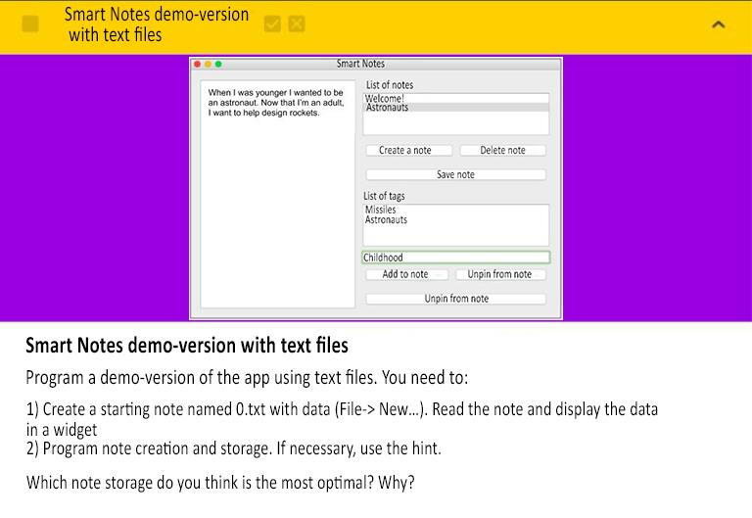
Complete tasks in VS Code
“VSC: Smart Notes Analysis”
Program a demo version of the app using text files.
Which storage is the most optimal?
Working in VS Code
Notes:
Smart Notes demo-version with text files
Program a demo-version of the app using text files. You need to:
Create a starting note named 0.txt with data (File-> New…). Read the note and display the data in a widget
Program note creation and storage. If necessary, use the hint.
Which note storage do you think is the most optimal? Why?

Slide 45
Module 3. Lesson 4. The Smart Notes App. P. 3
Discussion:
Optimal data storage

Slide 46
Which way of storing notes is the most convenient?
What kind of data is suitable for storing in text files?
Discussion of tasks

Slide 47
Note structures within different kinds of files
Text files
Json files
Format:
One string = One piece of data
About the moon
Why is the moon a satellite?
#moon #planet
Format: a dictionary of dictionaries
{
"About the moon" : {
"text": "Why is the moon a satellite and not a planet?"
"tags": [ "moon", "planet" ]}
}
Discussion of tasks
0.txt
data.json
✅
✅

Slide 48
Conclusions:
Text files
Json files
Convenient for working with simple or non-standard data.
Convenient for working with structured data.
Discussion of tasks
Examples of suitable data: ?
Examples of suitable data: ?

Slide 49
Conclusions:
Text files
Text files
Json files
Json files
Convenient for working with simple or non-standard data.
Convenient for working with simple data. Files are easy to open on other devices.
Convenient for working with structured data.
Convenient for working with structured data.
Discussion of tasks
Examples:
List of surnames (simple data that can be read with one command)
Book text for analysis (unstructured data where every word needs to be analyzed)
Examples:
Data from a questionnaire (all of the data is distributed into fields).
Database for a grocery stockroom (all of the products have the same properties: quantity, expiration date, etc.).

Slide 50

Module 3. Lesson 4. The Smart Notes App. P. 3
Wrapping up the work day

Slide 51


List all of the files that you now know how to work with.
Wrapping up the work day

Slide 52
We can use:
Files with .ру programs and modules
.txt Text files
Text files with a .json structure
We can use .jpg/.png
Wrapping up the work day

Slide 53
We can use:
Files with .ру programs and modules
.txt Text files
Text files with a .json structure
We can use .jpg/.png
We can use and change data stored in these files.
Wrapping up the work day
We can use a ready-made file without changing it.

Slide 54
We can use:
Files with .ру programs and modules
.txt Text files
Text files with a .json structure
We can use .jpg/.png
We can use and change data stored in these files.
Wrapping up the work day
We can use a ready-made file without changing it.
Actually, we can also analyze and change graphic files using Python.
We will cover this in the next module.
Notes:
Slide for the Python Start group which will enter their second year of study in 2020/2021

